Slide 1

Normalization for Relational Databases
UNIT -3 :Database Design & Normalization

Slide 2
Third Normal Form
A relation that is in First and Second Normal Form and in which no non-primary-key attribute is transitively dependent on the primary key, then it is in Third Normal Form (3NF).
A relation is in third normal form, if there is no transitive dependency for non-prime attributes as well as it is in second normal form.

Slide 3
3NF
A database is in 3NF, if it satisfies the following conditions:
It is in second normal form (2NF).
There is no transitive functional dependency.
Note – If A->B and B->C are two FDs then
A->C is called transitive functional
dependency.

Slide 4
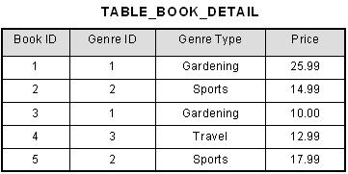
Example : 3NF
In the table , [Book ID] determines [Genre ID], and [Genre ID]
determines [Genre Type]. Therefore, [Book ID] determines
[Genre Type] via [Genre ID] and we have transitive functional dependency, and this structure does not satisfy third normal form.

Slide 5
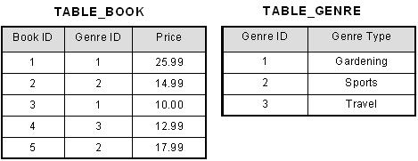
Example : 3NF
Now all non-key attributes are fully functional dependent only on the primary key. In [TABLE_BOOK],both [Genre ID] and [Price] are only dependent on [Book ID]. In [TABLE_GENRE], [Genre Type] is only dependent on [Genre ID].

Slide 6
3NF
The normalization of 2NF relations to 3NF involves the removal of transitive dependencies.
If a transitive dependency exists, we remove the transitively dependent attribute(s) from the relation by placing the attribute(s) in a new relation along with a copy of the determinant.

Slide 7
Boyce-Codd Normal Form (BCNF)
Boyce-Codd Normal Form or BCNF is an extension to the third normal form, and is also known as 3.5 Normal Form.
A relation is in BCNF, if and only if, every determinant is a Form (BCNF) candidate key.

Slide 8
BCNF
BCNF is an extension to Third Normal Form (3NF) and is slightly stronger than 3NF.
A relation R is in BCNF, if P -> Q is a trivial functional dependency and P is a super key for R.
If a relation is in BCNF, that would mean that redundancy based on function dependency have been removed.

Slide 9
Example- BCNF
The above relation is in 1NF, 2NF, 3NF, but not in BCNF.
Here is the reason − Functional Dependency
{Package->Ground}

Slide 10
Example: BCNF
It has the determinant attribute Package on which Ground depends on is neither a Candidate Key nor a superset of the candidate key.
Now the above tables are in BCNF.
Candidate key for <Package> table are Package and Ground
Candidate key for <TomorrowBookings> table are {Ground, Begin_Time} and {Ground, End_Time}
The anomaly eliminated because we used Package as a key in the <Package> relation.

Slide 11
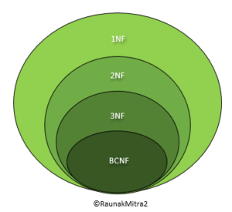
The Normal Forms Hierarchy

Slide 12
Summary
NORMALIZATIONS | SHOULD NOT CONTAINS | SHOULD PRESERVES
1st NF | Multivalued Attribute | Single valued Attributes
2nd NF | Partial Dependency | 1NF
3rd NF | Transitive Functional Dependency | 2NF
BCNF | Non-prime attribute derives prime attribute | 3NF
FORMULA | MPTN

Slide 13
References
https://www.youtube.com/watch?v=IeSai2JVm78
https://www.youtube.com/watch?v=NNjUhvvwOrk&feature=emb_logo

